Slide 1
Inter-Process Communication ( 2 ).

Slide 2
Parallelism.
CPU 0
CPU 1
CPU 2
Shared memory
Start Pgm1
Open file 2
Write rec10
Close file 2
End Pgm1

Slide 3
General purpose MIMD.
Shared memory µ-procs:
use central memory for communication purpose
interconnection methods between procs and memory
Message-passing µ-procs:
a local memory is attached to each procs
direct links to pass data between procs
interconnection methods between procs.

Slide 4
Shared memory programming model.
Synchronisation
Process
Process
Process
Process
DATA

Slide 5
Message-passing programming model.
Messages
Process
Process
Process
Process
DATA
DATA
DATA
DATA

Slide 6
Non-determinate.
No assurance that repeated execution of a parallel program will produce the same results.
Mainly due to the absence of critical sections.
Execution results depends of the execution order or the presence of parallel processes !!!
Need to build determinate software.

Slide 7
Synchronisation
Coordinating processes:
Workload is spread on n processes
Final results exploitable after consolidation
Communication through messages or wait/post mechanism

Slide 8
Mutual exclusion.
Concurrent processes.
N processes share same data or same resources
Execution needs to be determinate
Critical section mechanism through semaphore or message usage.

Slide 9
Race condition
Two parallel processes use a common resource:
Pa is the first process started by the scheduler
Pa reads a common variable and is interrupted
Pb is started by the scheduler, reads and modify the common variable.
Pb has win the race -> race condition.
Pa is restarted and modify the variable according to old value!!
If race condition exists, program behaviour is non-determinate
A critical section has to be implemented.

Slide 10
Deadlocks
Mutual exclusion
Process Pa uses resource Rb: exclusive use of Rb
Process Pb uses resource Ra: exclusive use of Ra
Process Pa wants to use resource Ra but waits
Process Pb wants to use resource Rb but waits
->Deadlock situation.

Slide 11
Critical section rules.
Mutual exclusion: Only one process at a time should be allowed in its critical section
Progress: Suppose a critical section is free. If a process indicates a need to enter into the critical section, it may not wait.
Bounded wait: No process can be postponed indefinitely to enter its critical section.
Number independent (opt.): Critical sections implementation does not rely on the processors number or speed

Slide 12
Implementing critical sections
Interrupt disabling
Shared variable testing
Strict alternation
Peterson’s solution and TS/CS
Sleep et Wakeup primitives usage
Semaphore solution

Slide 13
Interrupt disabling
dcl shared Ice_cream;
Program for process Pa
disable Interrupts ();
eat(Ice_cream);
enable Interrupts;
/* Shared variables*/
Program for process Pb
disable Interrupts ();
eat(Ice_cream);
enable Interrupts;

Slide 14
Shared variable testing.
dcl shared lock=FALSE;
dcl shared Ice_cream;
while (lock) {NULL};
lock = TRUE;
eat(Ice_cream);
lock=FALSE;
end while;
/*Shared variables*/
while (lock) {NULL};
lock = TRUE;
eat(Ice_cream);
lock=FALSE;
end while;

Slide 15
Shared variable testing problem.
dcl shared lock=FALSE;
dcl shared Ice_cream;
while (lock) {NULL};
lock = TRUE;
eat(Ice_cream);
/*Shared variables*/
while (lock) {NULL};
lock = TRUE;
eat(Ice_cream);
Interrupt

Slide 16
Strict alternation.
dcl shared turn;
dcl shared Ice_cream;
while (turn != 0) {NULL};
eat(Ice_cream);
turn=1;
wash_up;
/* Shared variables */
while (turn != 1) {NULL};
eat(Ice_cream);
turn=0;
wash_up;

Slide 17
Peterson’s solution.
flag[0] = 0;
flag[1] = 0;
turn;
P0: flag[0] = 1; P1: flag[1] = 1;
turn = 1; turn = 0;
while (flag[1] == 1 && turn == 1) while (flag[0] == 1 && turn == 0)
{ {
// busy wait // busy wait
} }
// critical section // critical section
... ...
// end of critical section // end of critical section
flag[0] = 0; flag[1] = 0;

Slide 18
TS/CS
Test and set (or Compare and Swap) is a machine instruction
TS(m) execution
causes the contents of memory location m to be loaded in a register
positions condition code depending on the value stored in register
writes a value ( e.g. True ) at memory location m
Indivisible instruction.

Slide 19
Peterson and TS.
dcl shared lock=0;
P0: P1:
while (test_and_set(lock) == 1) while (test_and_set(lock) == 1)
{ {
// busy wait // busy wait
} }
// critical section // critical section
... ...
// end of critical section // end of critical section
lock = 0; lock = 0;

Slide 20
Implementing critical sections
Interrupt disabling
Shared variable testing
Strict alternation
Peterson’s solution and TS/CS
Sleep et Wakeup primitives usage
Semaphore solution
I/O and SVC perturbation
Race condition
Performance impact
Still busy waiting

Slide 21
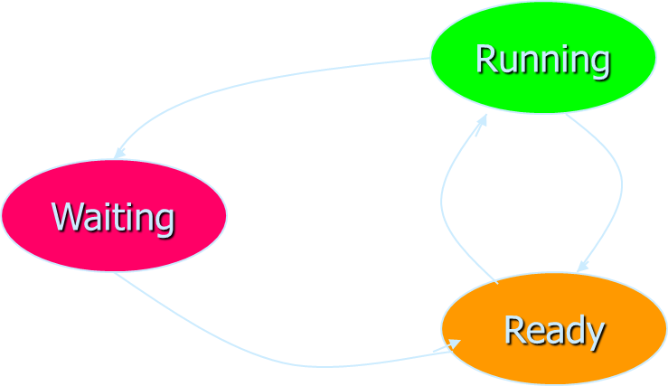


Sleep and wake_up.
System’s primitives
Sleep: changes process state from running to waiting
Wake_up: changes process state from waiting to ready.
Avoid busy waiting.

Slide 22
Producer and consumer.
Two processes:
one produces information: the producer
one consumes information: the consumer
Producer:
fills an empty buffer pool with information
Consumer:
copies information out of a buffer
There is a finite ( N ) number of buffers in the buffer pool

Slide 23
Producer and consumer
Producer
Consumer
Buffer Pool

Slide 24
Producer and consumer
Dcl N=100; dcl count = 0; /* nbr of slots in buffer pool;nbr items*/
void producer; dcl ice_cream;
while(TRUE)
{ produce(&ice_cream);
if (count == N) sleep();
/* if buffer pool full, wait */
store(&ice_cream);
/*put item in one buffer*/
count = count + 1;
if (count == 1) wakeup(consumer);
}
Void consumer;
while (TRUE)
{ if (count == 0 ) sleep();
/* buffer pool is empty*/
remove(&ice_cream);
count= count -1;
if (count == N-1) wakeup(producer);
/* buffer was full */
consume(ice_cream);
}
/* miam-miam */

Slide 25
Semaphores.
Nonnegative integer variable changed or tested only by 3 indivisible access routines:
Init(s, i): [ s = i ] /* single use! */
Up(s): [ s =s + 1; if ( s==1) {post}]
Down(s): [while (s==0) {wait}; s = s-1 ]
Operations are indivisible or atomic
Originally introduced by Dijkstra (68), up was V for Verhogen and down was P for Proberen

Slide 26
Semaphores.
Can be seen as a traffic light :
if == 0, process stops ( red light )
if > 0, process go trough ( green light)
if was 0, process is posted
Can be seen as a counter:
counts the number of up less the number of down
never less than 0

Slide 27
Semaphores.
Variant: integer variable;
Up(s): [ s = s + 1; if (s ≤ 0) {wakeup} ]
Down(s): [ s = s – 1; if (s < 0) {sleep} ]
Sleep: add to the semaphore's queue
-s: length of the queue of waiting processes

Slide 28
Semaphore properties
N(up) + I ≥ N(down)
Where:
N(up) = number of up on the semaphore
N(down) = number of down on the semaphore
I = initial value of the semaphore
Val(sem) = N(up) - N(down) + I ≥ 0

Slide 29
Coordinating processes.
dcl proceed semaphore; init (proceed, 0);
Processus 1
down(proceed);
Process Process_1;
Processus 2
Process Process_2;
up(proceed);
N (up) + 0 ≥ N(down)

Slide 30
Concurrent processes.
dcl mutex semaphore; init (mutex, 1);
Processus 1
down(mutex);
eat(ice_cream);
up(mutex);
Processus 2
down(mutex);
eat(ice_cream);
up(mutex);
N (up) + 1 ≥ N(down)

Slide 31
Semaphore types
Binary semaphores: locks
Process synchronisation: initialised to 0
Special case: mutex, initialised to 1
Counting semaphores: number of available resources, size of a buffer, …
Typically initialised to “n”
Eventually becoming negative to count semaphore waiting queue length

